Slide 1
Pomodoro-website blocker
Monday
Friday
WORK
FOCUS ON MENTAL HEALTH
BY: HARIKA
Thursday
Tuesday
MEDITATE
WALK
ASSIGNMENTS
Wednesday
WORK ON PROJECTS

Slide 2

INTRODUCTION
A to-do list and the Pomodoro technique are well-known methods for time management, which is essential for productivity. Distractions are a serious issue that can hinder productivity, though, especially in the age of social media. For this reason, my aim for this project is to develop a program that combines the To-do list and the Pomodoro method, allowing users to keep track of their to-do lists. The program will also contain a website blocking tool that disables social media websites during work hours.

Slide 3
AIM
The Pomodoro and Website Blocker Program offers a disciplined approach to work, lessens distractions, and enhances time management, which can assist people in overcoming typical productivity issues. People may use this method to become more productive, feel less stressed, and accomplish their goals more successfully.

Slide 4
USES
Time management
Reduced Procrastination
Increased productivity.
Improved focus

Slide 5
MODULES USED:
os
platform
time
sys
Playsound

Slide 6
IMPLEMENTATION PLAN:
The user enters their working hours, sets the Pomodoro duration, and break time interval after importing these modules, and the system reminds them when it's time to start working and when to take a break. Social networking and other pointless websites will be prohibited during this time.

Slide 7
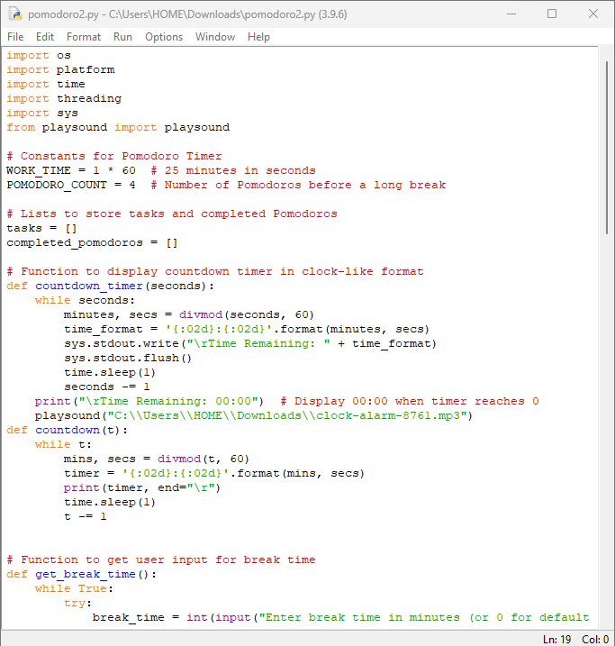
CODE

Slide 8
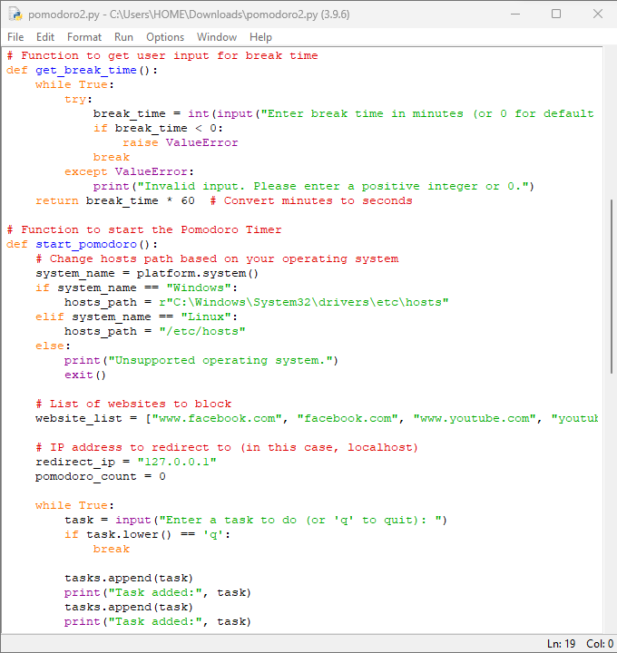

Slide 9
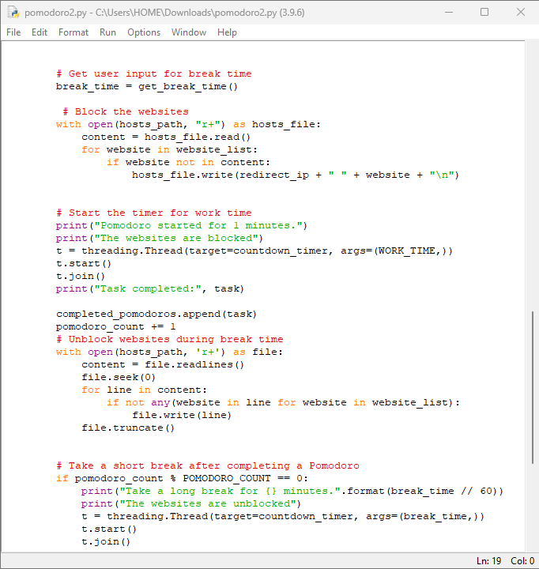

Slide 10
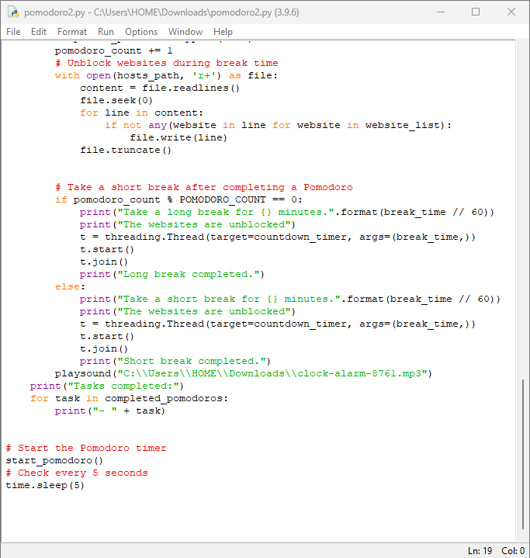

Slide 11
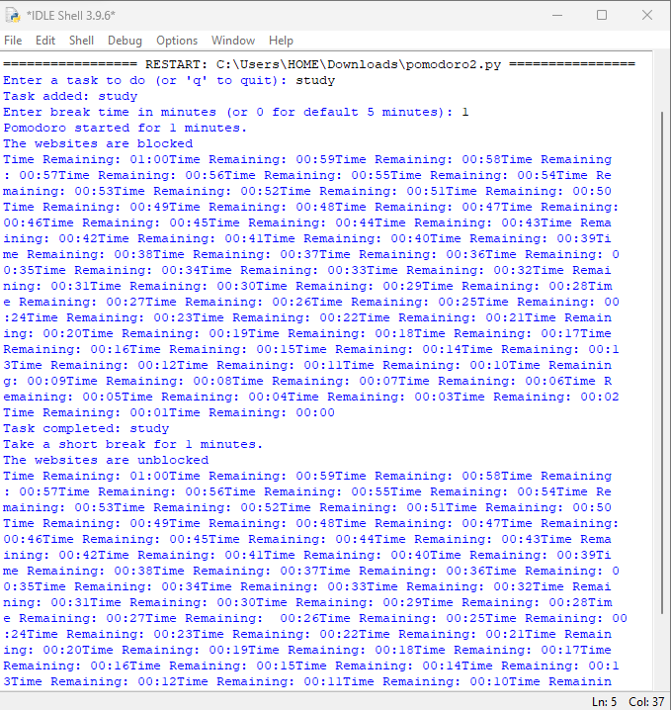

Slide 12
THANK YOU

